Slide 1
Exam Seating ARRANGEMENT SYSTEM
ADITYA. V Roll NO : 22011101007
AVINASH. M Roll No : 22011101019
CLASS : AI & DS - A

Slide 2
CONTENTS
Introduction
Team member contribution
Working of the program
Sample output
Summary

Slide 3
INTRODUCTION
Using Java program, we have done a seating arrangement system with a graphical user interface (GUI). This program allows you to create seating arrangements for multiple classrooms with benches and rows and assign students to those seats.

Slide 4
TEAM MEMBERS CONTRIBUTIONS

Slide 5
Array list, GUI & Other Basic Function
Member 1:
Aditya. V
Roll NO : 22011101007

Slide 6
File HANDLING, Exception Handling & GUI
Member 2:
Avinash. M
Roll No : 22011101019

Slide 7
Code Working
The provided Java code is a Swing-based GUI application that allows you to create and display a seating arrangement for students in multiple classrooms. It consists of several classes and methods that handle the GUI setup, data input, seat assignment, and output.

Slide 8
Student Class
The Student class represents a student with the following attributes:
1. roll_Number: The student's roll number.
2. row: The row where the student is seated.
3. bench: The bench number where the student is seated.
The class has a constructor that allows you to create a Student object by providing the roll number, row, and bench.

Slide 9
Class_room Class
The Class_room class represents a classroom with the following attributes:
room_Number: The classroom's unique identifier.
benches: The number of benches in the classroom.
rows: The number of rows in the classroom.
students: An ArrayList to store student objects seated in classroom.
The class has a constructor to create a Class_room object, specifying the room number, benches, and rows. It also initializes the students ArrayList.

Slide 10
Seating_arrangement_GUI Class
This is the main class that contains the application's entry point and the graphical user interface (GUI) setup.
The ‘main’ method invokes the ‘createAndShowGUI’ method to set up the GUI.
‘createAndShowGUI’ Method:
This method is called when the "Start Seating Arrangement" button is pressed.
It collects input data from the user, including the number of classrooms, classroom details (benches, rows), and total students.
It iterates through the classrooms, prompting the user to enter details for each classroom.

Slide 11
After gathering classroom information, it collects student data and assigns seats in the classrooms using the assignSeat method.
Finally, it displays the seating arrangement in the GUI's JTextArea and writes it to a file using the displayAndWriteToFile method.
createInputPanel and createOutputPanel Methods:
These methods create the input and output panels for the GUI.
The input panel includes labels and text fields for entering classroom and student details.
The output panel contains a JTextArea within a JScrollPane for displaying the seating arrangement.

Slide 12
startSeatingArrangement Method:
This method is called when the "Start Seating Arrangement" button is pressed.
It collects input data from the user, including the number of classrooms, classroom details (benches, rows), and total students.
It iterates through the classrooms, prompting the user to enter details for each classroom.
After gathering classroom information, it collects student data and assigns seats in the classrooms using the assignSeat method.
Finally, it displays the seating arrangement in the GUI's JTextArea and writes it to a file using the displayAndWriteToFile method.

Slide 13
‘assignSeat’ Method:
This method is responsible for assigning seats to students within the classrooms.
It iterates through rows and benches in each classroom, checking seat availability.
If a seat is available, it assigns the seat to a student.
‘displayAndWriteToFile’ Method:
This method displays the seating arrangement in the GUI's JTextArea and writes it to a text file named "Seating_Arrangement.txt."
It uses try-catch blocks to handle any exceptions that may occur during file operations
The Student and Class_room classes are used to organize and manage student and classroom data, respectively. Students are assigned seats within classrooms using these classes.

Slide 14
Sample INPUT & output

Slide 15
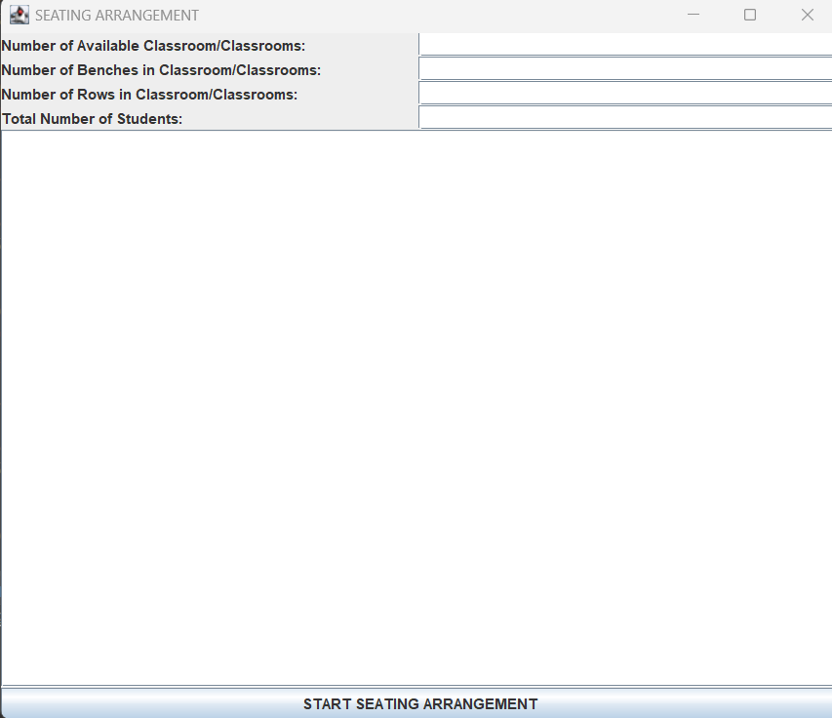
Gui interface

Slide 16
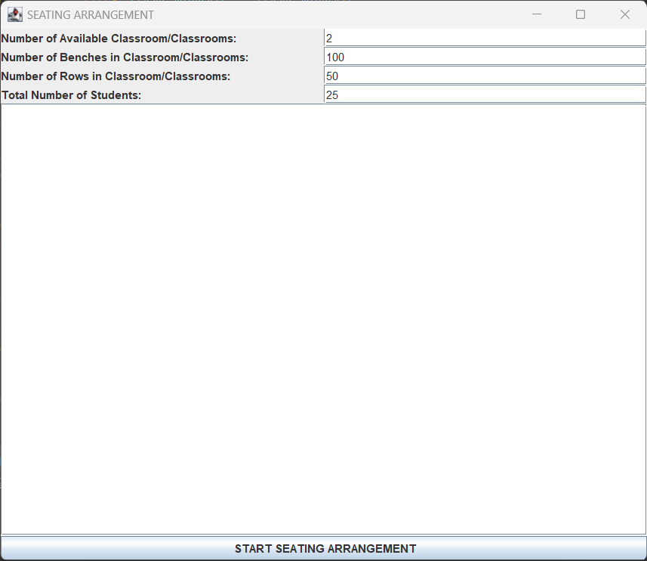
INPUT FOR CLASSROOM, BENCHES, ROWS & STUDENTS

Slide 17
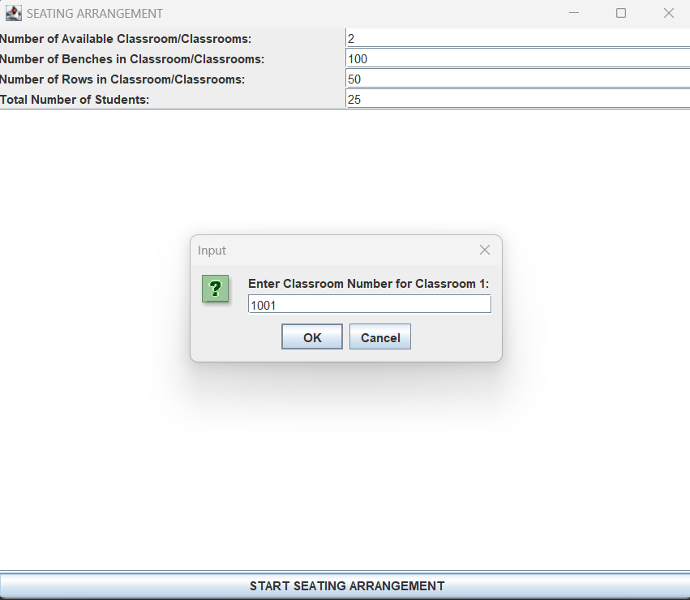
INPUT FOR UNIQUE ROOM NUMBER FOR FIRST CLASSROOM

Slide 18
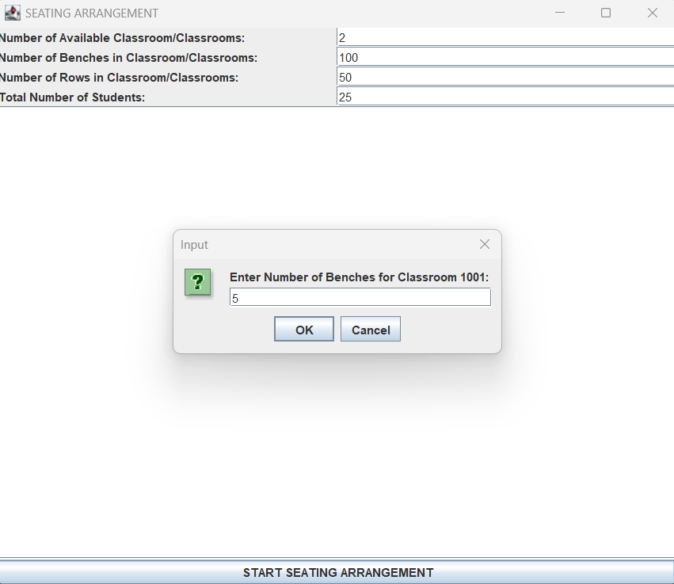
INPUT FOR THE NUMBER OF BENCHES PER ROW FOR FIRST CLASSROOM

Slide 19
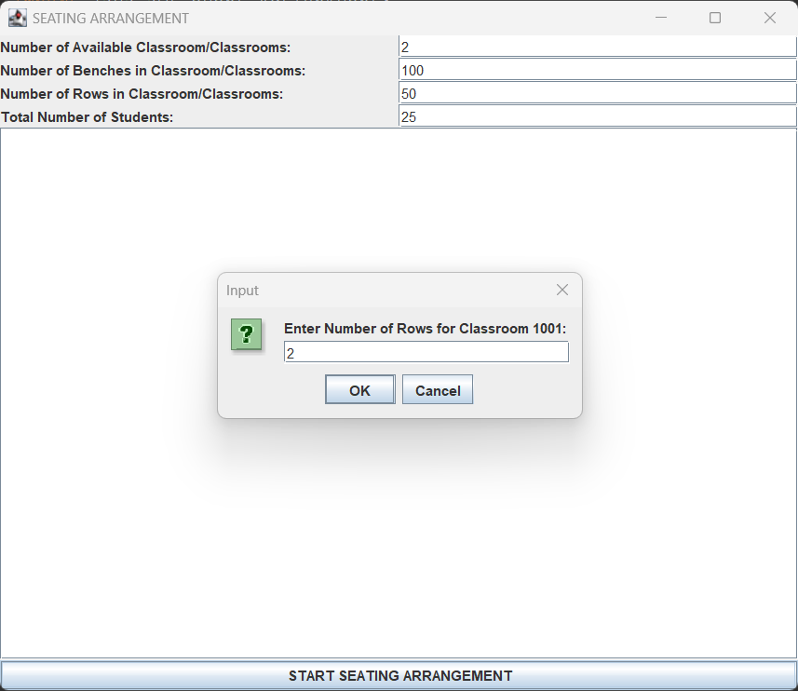
INPUT FOR THE NUMBER OF ROWS FOR FIRST CLASSROOM
(THE PREVIOUS AND THIS STEP WILL CONTINUE FOR THE SECOND CLASSROOM AS WELL )

Slide 20
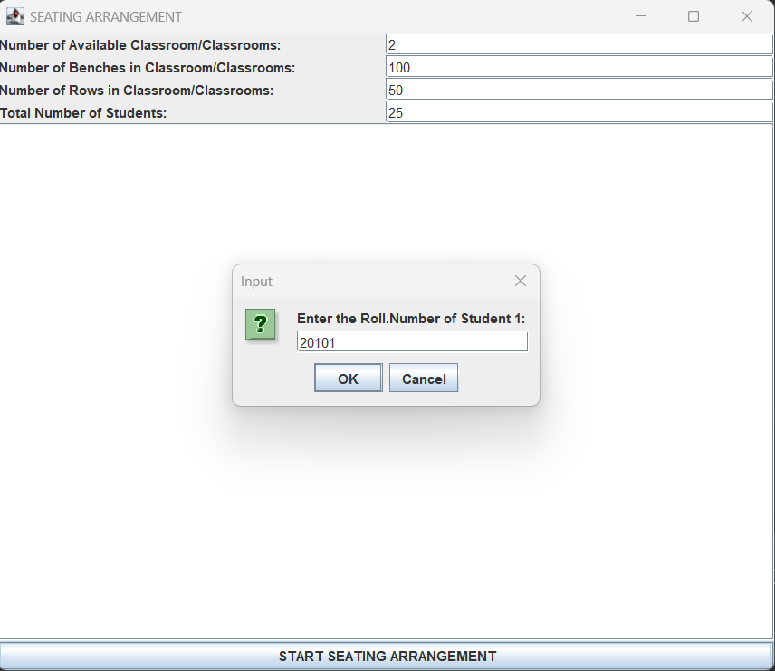
ENTERING THE ROLL NUMBER FOR STUDENTS (THIS STEP CONTINUES UNTIL ENTERING THE ROLL NUMBER FOR ALL STUDENTS(I.E 20) )

Slide 21
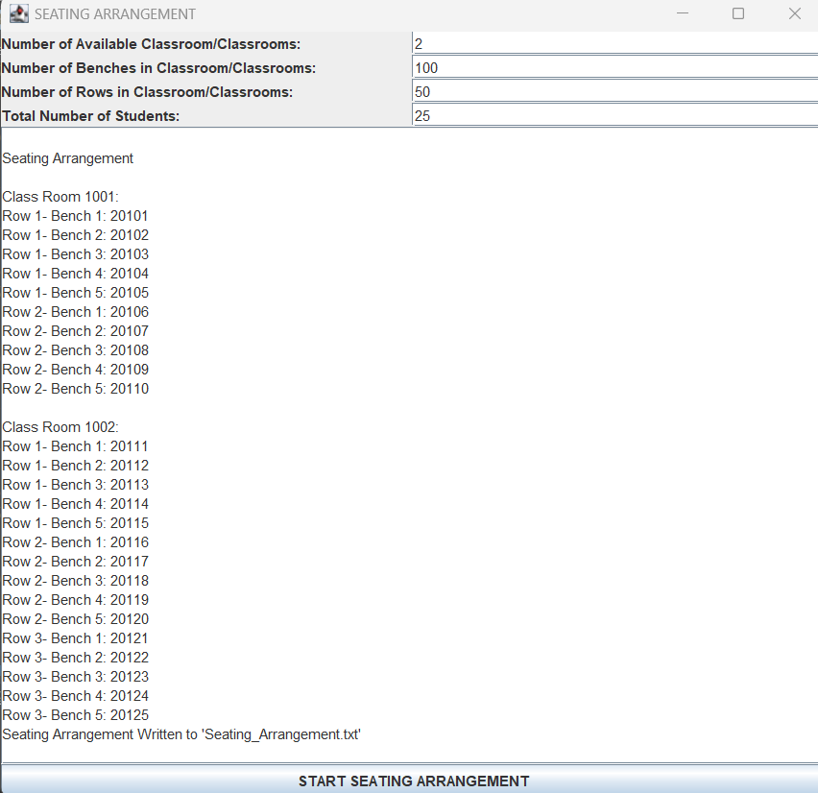
Final OUTPUT

Slide 22
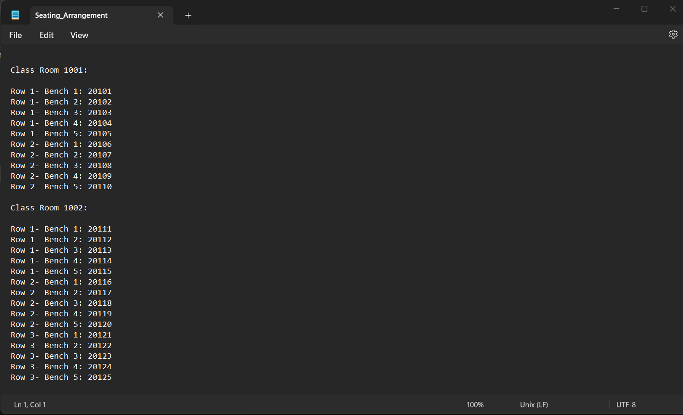
Screenshot OF DATA WRITTEN TO THE TEXT FILE

Slide 23
SUMMARY
This Java application employs a user-friendly Swing GUI to dynamically allocate student seats in various classrooms. It facilitates data input, seat assignments, and delivers a visual representation of the seating plan within the GUI, as well as an exportable file for record-keeping.

Slide 24
THANK YOU

